Slide 1

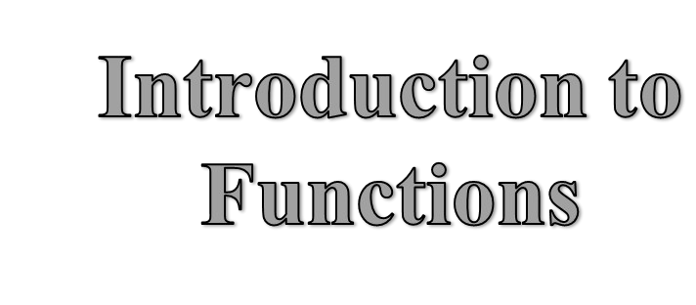





Slide 2




FUNCTIONS
A function is a named block of code that perform some action.
The statement written in function are executed when it is called by name.
Each action has unique name . Function are the building block of c++ programs.
They are used to perform the tasks that are repeated many times

Slide 3


Importance of Function
A program may need to repeat the same piece of code at various places.
It may be required to perform certain task repeatedly.
The program may become very large if functions are not used.
The real reason for using function is to divide program into different parts.

Slide 4

Advantages of Functions
Easier to Code
Easier to Modify
Easier to Maintain
Reusability
Less Programming Time
Easier to Understand

Slide 5



C++ Functions
C++ allows the use of both user- defined and Built-in functions.
Built-in are usually grouped into specialized libraries (e.g., iostream, stdlib, math, etc.)

Slide 6

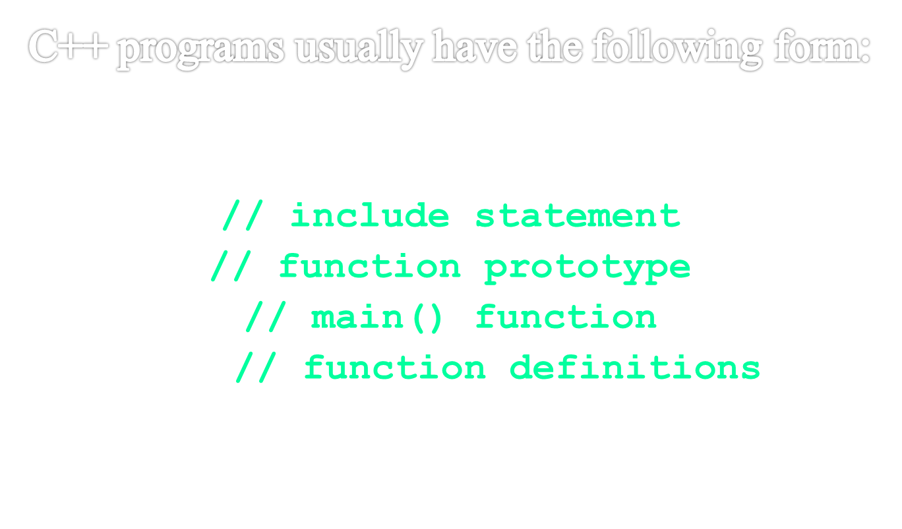


Slide 7

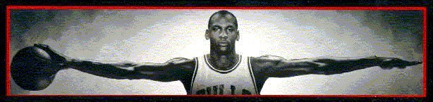


Function Input and Output

Slide 8

Function Declaration
Function declaration is the model of a function. It is also known as FUNCTION PROTOTYPE. It provides information to compiler about the structure of function to be used in program. It ends with semicolon (;). It consists of:
FUNCTION NAME
FUNCTION RETURN TYPE
NUMBERS & TYPES OF PARAMETERS

Slide 9
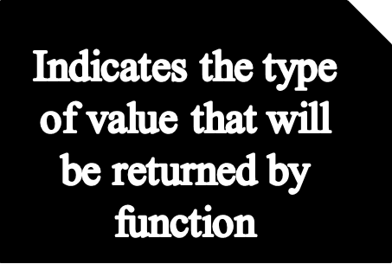
Syntax of Function Declaration
Return-type Function-name (parameters);
Indicates the
Parameters are
name of
the values that
function
are provided to a
function when the function is called.

Slide 10





A set of statements that explains what a function does is called FUNCTION
Definition
A function definition can be written at: Before main() function
After main() function In a separate file
•
•
•

Slide 11
Syntax of Function Definition
Return-type
Function-name (parameters)
Function header
{
statement 1;
statement 2;
:
Function body
:
:
statement N;
}

Slide 12
Types of user-defined function
No Return , No Parameter
No Return , With Parameter
With Return , No Parameter
With Return , With Parameter

Slide 13
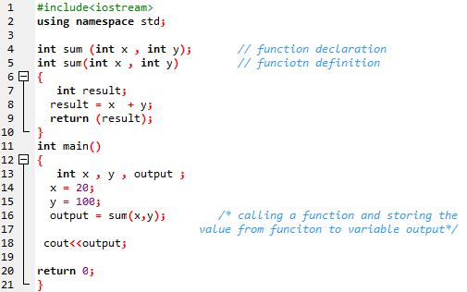
Example of Function Declaration & Function Definition
Using With Return , With Parameter

Slide 14
Function Call
The statement that activates a function is known as FUNCTION CALL.The following steps
take place when a function is called:
The control moves to the function that is called.
All statements in function body are executed.
Control returns back to calling function.

Slide 15
Function Call Mechanism
Called function
Void main()
{
……. Fun();
Void Fun()
{
…..
…..
}
Function calls
…….
…….
Fun();
…….
}

Slide 16


Scope of Functions
Area in which a function can be accessed is known as SCOPE OF FUNCTION.
These are two types:
1. Local Function
A function that is declared in another function is called Local Function.
1. Global Function
A function that is declared outside any function is called Global Function.

Slide 17
Local Variable
Global Variable
•
•
•
•
Local variables are declares within a function.
It can be used only in function in which they declared.
Local variable are destroyed when control leave the function.
Local variables are used when the values are to be used within a function.
•
•
•
•
Global variables are declares outside any function
Global variables can be used in all function.
Global variable are destroyed when the program is terminated.
Global variables are used when values are to be shared among different functions.

Slide 18
Thank You

